Slide 1
MIPS and floating point
processor

Slide 2
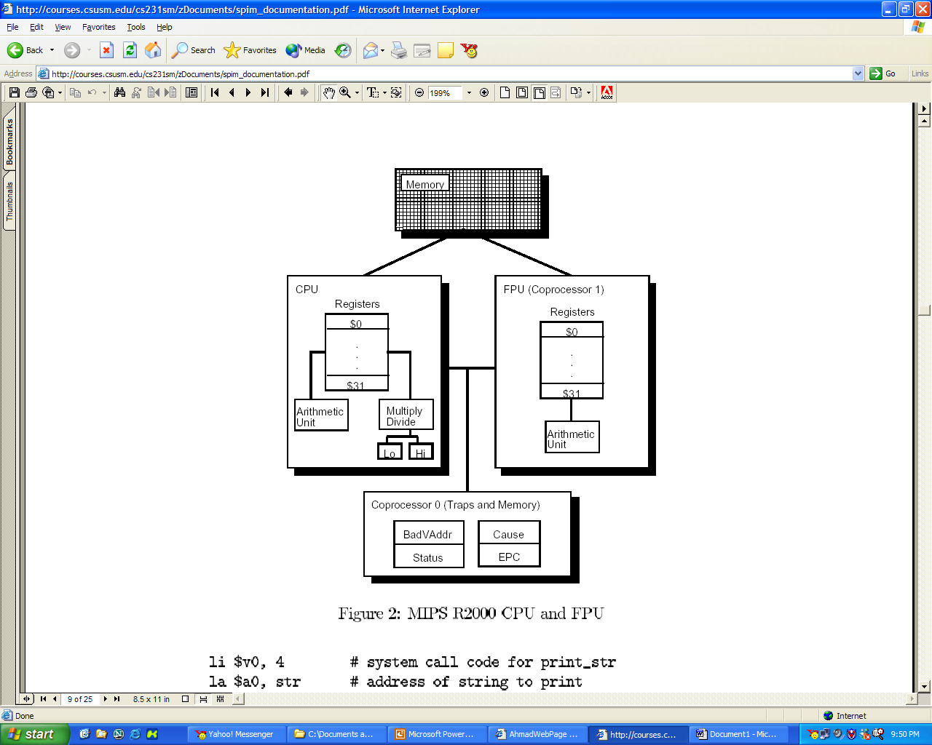

Slide 3
Floating point processor
MIPS has a floating point co processor (numbered 1) that operates on
  single precision (32 bits) that represent numbers as small as
  2.0 x 10⁻³⁸ to as large as 2.0 x 10³⁸ and
  double precision (64 bits) floating point numbers that represent numbers almost as small as 2.0 x 10⁻³⁰⁸ to almost
  as large as 2.0 x 10³⁰⁸
This processor has its own registers, which are numbered $f0-$f31.
Because these registers are only 32 bits wide, two of them required to hold doubles.

Slide 4
Transfer instructions between two processors
Values can be moved in or out main processor’s registers (integer processor) to coprocessor1 (floating point processor) registers by using mtc1 and mfc1 instructions.
  mtc1 $v0, $f1 # move the content of $v0 to coprocessor1 and place in $f1
  mfc1 $f1, $v0 # move the content $f1 from coprocessor1 to $v0 in main processor

Slide 5
Convert instructions for floating points to integer and vice versa
After the content of registers are transferred between the processor, their value needs to get converted from integer to single or double floating point and vice versa.
  mtc1 $v0, $f1 # move the integer value of $v0 to coprocessor1 and place in $f1
  cvt.s.w $f1, $f1 #convert the integer in $f1 into $f1 as single floating point.
  mfc1 $f1, $v0 # move the content $f1 from coprocessor1 to $v0 in main processor
  cvt.w.s $v0, $v0 #convert the single floating point in $v0 into $v0 as an integer.

Slide 6
Addition and Subtraction
First Case: When the dealing with single floating points
        1 2 3 4
        add.s $f1, $f2, $f3
  add single floating point values
  Operand that gets the result (destination register)
  First operand for operations (Source1 register)
  Second operand for operations(Source2 register)
Second Case: When the dealing with double floating points
        1 2 3 4
        add.d $f2, $f4, $f6
  1) add double floating point values
2) Operand that gets the result (destination register)
3) First operand for operations (Source1 register)
4) Second operand for operations(Source2 register)

Slide 7
Other instructions
You can see the list and description of all floating point instruction from a link off of the course main web page.
  sub .d $f2, $f4, $f6 # subtraction on double floating point values
  sub .s $f1, $f2, $f3 # subtraction on single floating point values
  div.d $f2, $f4, $f6 # division on double floating point values
  div.s $f1, $f2, $f3 # division on single floating point values
  mul.s $f1, $f2, $f3 # multiplication on single floating point values
  mul.d $f2, $f4, $f6 # multiplication on double floating point values
  mov.s $f1, $f2 # move the single float from $f2 to $f1
  mov.d $f2,$f4 # move the single float from $f2 to $f1

Slide 8

System call
Code | Service | Arguments | Result | Comments
1 | Print integer | $a0=integer
2 | Print float | $f12=float
3 | Print double | $f12=double
4 | Print string | $a0=string |  | (address)
5 | Read integer |  | integer in $v0
6 | Read float |  | float in $f0
7 | Print double |  | double in $f0
8 | Read string | $a0=buffer, $a1=length
9 | sbrk | $a0=amount | address in $v0
10 | exit

Slide 9
Example of printing a float
# This program will print number 27.5555 on screen. By looking at system call
# table, to print float first need to put the value of 2 into $v0 and then
# put the value that needs to be printed into $f12. and use syscall.
.data
num: .float 27.5555 # store 27.5555 foating value to #address indicated by num
.text
main:
li $v0, 2 # code for printing float (single)
l.s $f12 , num #load 27.5555 at address num into $f12
syscall #print the number

Slide 10
Example of inputting float
# This program will get the floating point number (single) from user and print it on the #screen. to get the number, by looking at system call table, we need to put the value of #6 into $v0 and then syscall will allow user to enter the value to $f0. and following #last example we can print the value.
.data
.text
main:
li $v0, 6 # code for getting float (single) from user
syscall # the entered value goes to $f0 after #syscall
li $v0, 2 # code for printing float (single)
mov.s $f12,$f0 # move that value that user entered from #$f0 to$f12 to get printed
syscall

